Slide 1
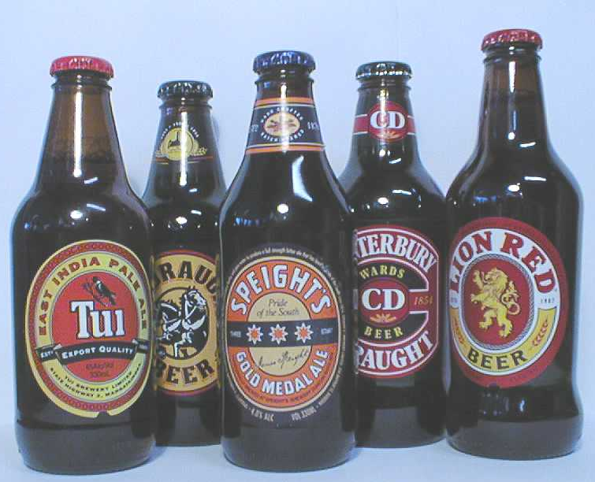
Please indicate which of the following you would buy if these were the prices per dozen:
Steinlager
Stella Artois
$18.95
□
$20.95
□
Heineken -XLN
Export Gold
$22.95
□
$14.95
□
Other premium beers
Other mainstream beers
19.95
□
$13.95
□
SCENARIO 1

Slide 2
Please indicate which of the following you would buy if these were the prices per dozen:
Steinlager
Stella Artois
$18.95
□
$20.95
□
Heineken
Export Gold
$22.95
□
$14.95
□
Other premium beers
Other mainstream beers
19.95
□
$13.95
□
SCENARIO 2

